Slide 1
The Battle of Neighbourhoods
-SAJAL SUHANE

Slide 2
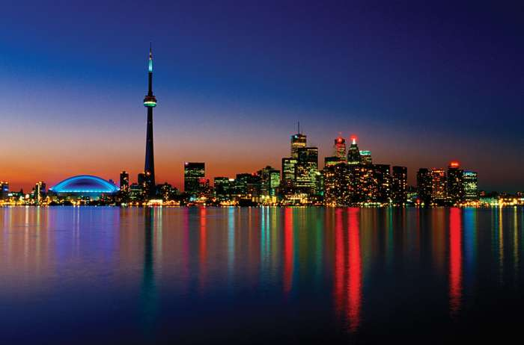
introduction
Business Approach:
Explore Neighbourhoods in Toronto
User wishes to shift
Look for similar venues in all parts of Toronto
Success Criterion:
Compare the neighbourhoods

Slide 3
Toronto City facts
Toronto, city, capital of the province of Ontario, south eastern Canada.
Most populous city in Canada.
A multicultural city, and the country’s financial and commercial centre.
The city is positioned on the edge of some of the best farmland in Canada, with a climate favourable to growing a wide range of crops, thereby making Toronto a transportation, distribution, and manufacturing centre.
Most importantly, its central location, along with a host of political policies favoring international trade, places this city with the greatest economic ties to, and influence from, the United States.

Slide 4
Business understanding
Project aims at Exploring neighbourhoods in Toronto.
User finds it convenient to use
It should help user to take decision

Slide 5
Analytic approach
Toronto has 4 Boroughs- East Toronto , West Toronto , Downtown Toronto, Central Toronto
Explore Queen's Park and Ontario Provincial Government and then the rest.
We get Parkwoods latitude and longitude values .
We find top 100 venues that are in Parkwoods within a radius of 500 meters.

Slide 6
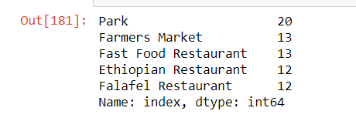
Exploratory Data Analysis
We use K means clustering for training the model.
We divide the city Toronto into two clusters.
Cluster 1 has 20 neighbourhoods in it which have 20 parks, 13 Farmers Market, 13 Fast Food Restaurant, 12 Ethiopian Restaurants and 12 Falafel Restaurants.

Slide 7
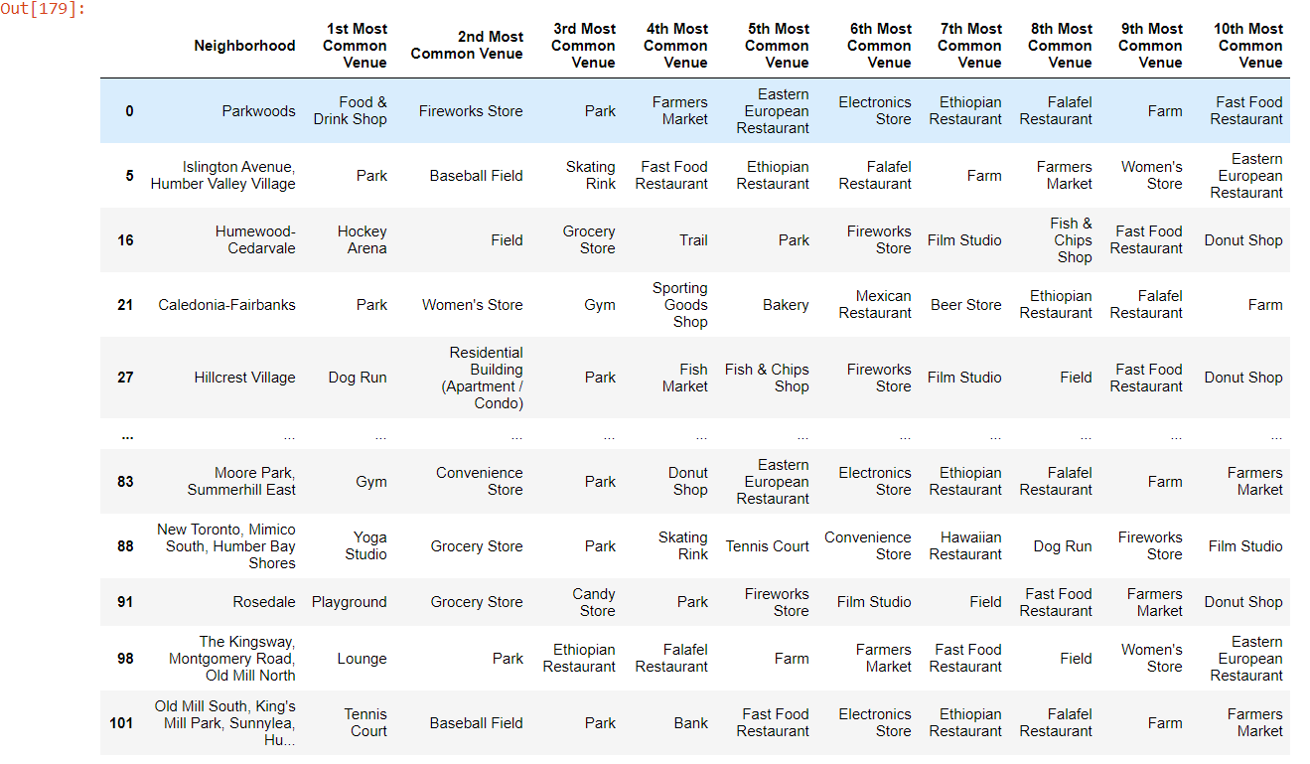
Neighbourhoods of cluster1

Slide 8
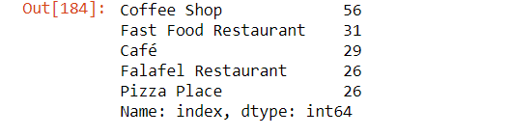
Exploratory data analysis
Cluster 2 has 82 neighbourhoods, which have 56 Coffee shops, 31 Fast Food Restaurant, 29 Cafes, 26 Falafel Restaurants , 26 Pizza Places.

Slide 9
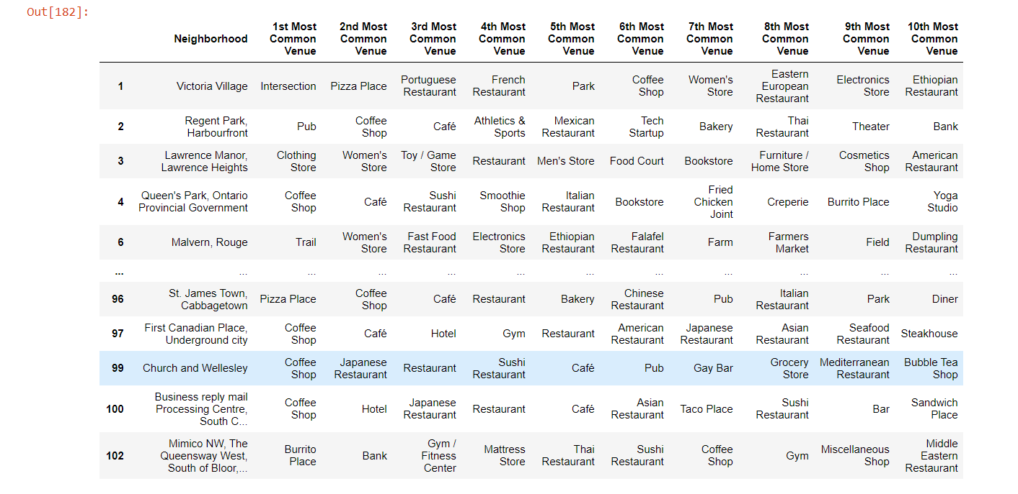
Neighbourhoods of cluster2

Slide 10
Result
The results show that cluster 1 has many parks, farmers markets and
Ethiopian restaurants while cluster 2 has many coffee shops/café and Pizza place.
Both places have many Fast Food and Falafel restaurants.

Slide 11
Discussion
Both the clusters have mostly the same venues in its neighbourhoods,
cluster 1 has more entertainment and sport facilities while
cluster 2 has more hangout places and both the places have
equal amount of restaurants.

Slide 12
conclusion
This analysis is performed on a limited data.
This may be right or wrong.
But if more amount of data is available there is scope of better results.

